Slide 1


Kammavari Sangham (R) 1952, K.S.Group of Institutions
K. S INSTITUTE OF TECHNOLOGY, BENGALURU-560109
(Affiliated to VTU, Belagavi & Approved by AICTE, New Delhi, Accredited by NAAC & IEI)
DEPARTMENT OF COMPUTER SCIENCE AND ENGINEERING Project Work Phase-2 (17CSP85) : Review-1
“API for Document Resizing, Validation and Verification“
Batch No: 2020_CSE_15
Group No: 03
Name | USN
BHAVESH BHANSALI | 1KS17CS016
GANESH MAUDGHALYA H G | 1KS17CS025
KARAN RAGHUNATH | 1KS17CS032
P KISHORE | 1KS17CS051
Under the Guidance of
Mrs. Vaneeta M
Associate Professor
Department of Computer Science and Engineering

Slide 2
Introduction
Literature survey
Problem Statement
Objectives
Methodology / Design
Modules
Technology & Tools Used
Implementation / Snapshots
References
AGENDA

Slide 3
INTRODUCTION
Technology has enabled us to upload and submit documents online at ease with computers, mobile phones, etc.
With this comfort there also comes the hassle of monitoring, adjusting size and dimensions of the document images(jpeg and png) and the clarity of the content in images requested by the websites.
Our service will help the website developers and the user to receive and upload images respectively without having to monitor the size(memory) and dimensions of images.

Slide 4

Our service will help the website developers and the user to receive and upload images respectively without having to monitor the size(memory) and dimensions of images.
Our product will be an API which on integration can be used by website developers for their website to resize images according to the size and/or dimensions of their requirement and verify the authenticity and clarity of content in images.
The version of the API that will be developed will provide verification for Aadhaar card, PAN card and Driving License. Further updates might include the implementation of verification of more documents.

Slide 5
Comparison with Similar Work
Previously People have used different image processing techniques on the document images along with PyTesseract to extract information from the document.
Those technique only work with only particular angle and same lighting and background conditions.
Even after apply multiple image processing techniques (like Guassian Blur, Thresholding, Canny edge detections etc) we were not able to get satisfactory results with Pytesseract for all the images and hence couldn’t generalise the process.
So instead of using PyTesseract we are using Google Cloud Vision API for the extraction of details from the document for further validation and verification.

Slide 6
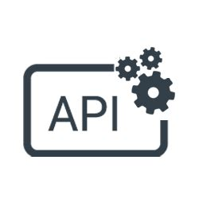
PROBLEM STATEMENT
“To design and develop a Web API to Resize, Validate and Verify Images to assist in the process of uploading Documents for the user”
OBJECTIVES
Successfully deploy a API to:
Resize Images based on size(memory) and dimensions
Extract information in the document using OCR
Check the validity of the document in the image uploaded
Verify the authenticity of the document

Slide 7
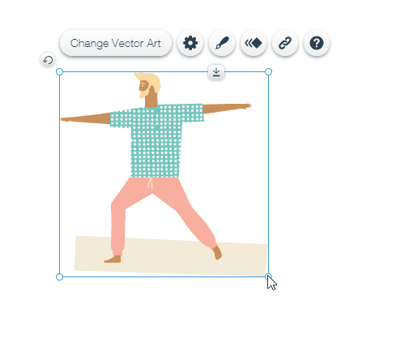


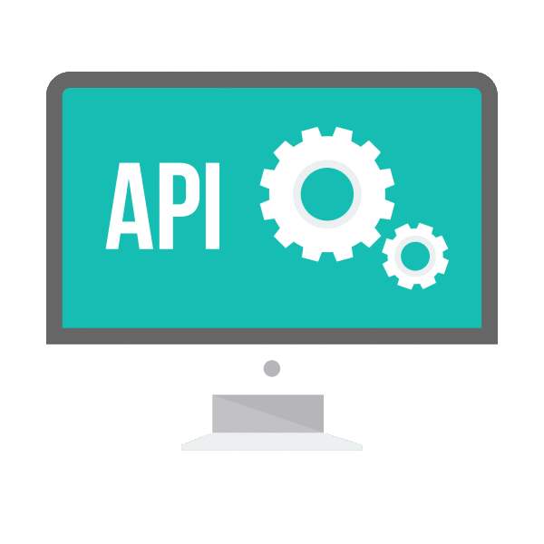


METHODOLOGY
UPLOAD
IMAGE(S)
USER
WEBSITE
ACTIVATE
API
RESIZE
OCR
VERIFY
DOCUMENT CHECK
Fig 1: Architectural Block Diagram

Slide 8
MODULES
Resizing:
OpenCV library will be used for resizing
The cv2.resize() function requires parameters of the size/dimensions of result image
OCR:
OCR will involve the usage of OpenCV, Pillow, Numpy and Google Cloud Vision to extract the important information like Name, Date of Birth, Card Number, etc. from the document content in the image.

Slide 9
Validation:
Validation will include the usage of OCR information extracted and the checking of the validity of the document (whether the right document image is uploaded in the right field or not).
Verification:
Verification of Aadhar card is done by using https://resident.uidai.gov.in/verify website (Web Scraping) which verifies a valid Aadhar number by prompting Green tick mark
For PAN card, we’ll use https://www.incometaxindiaefiling.gov.in/ to check if the PAN number exists.

Slide 10
TECHNOLOGY AND TOOLS USED
Software Requirements
Python 3.6
HTML
FLASK
Windows / MAC OS / Ubuntu OS
Jupyter notebook / VS Code
Libraries Used:
OpenCV
Selenium
Google Cloud Vision

Slide 11
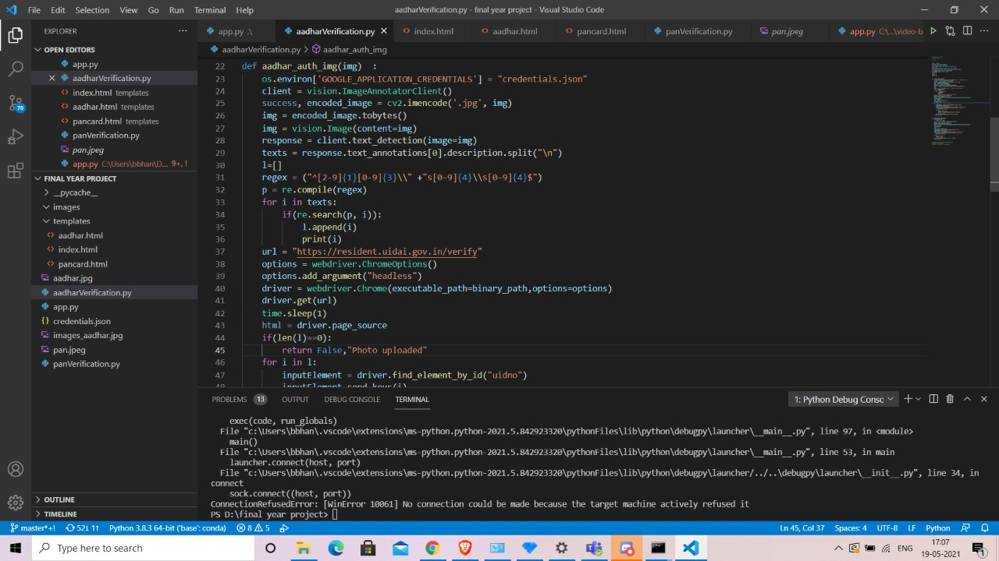
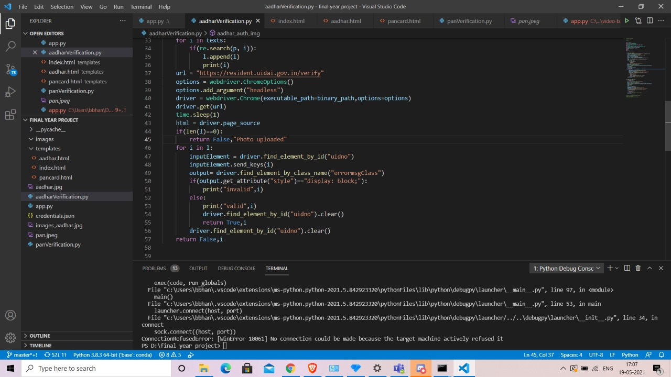
IMPLEMENTATION / SNAPSHOTS
Fig 2(a) & (b): Aadhar Details Verification

Slide 12
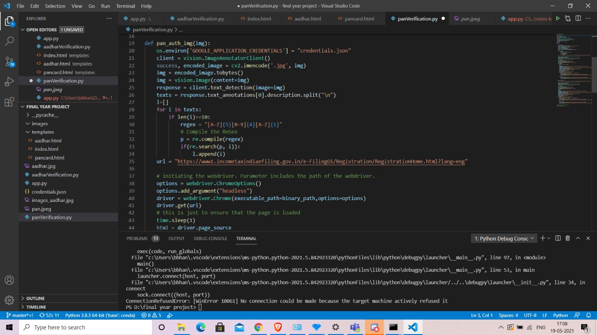
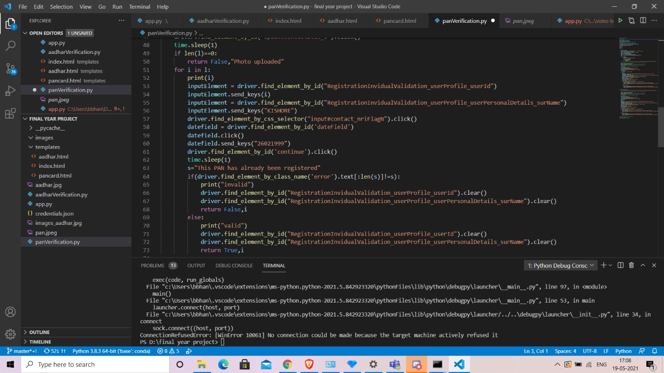
Fig 3(a) & (b): PAN Card Details Verification

Slide 13
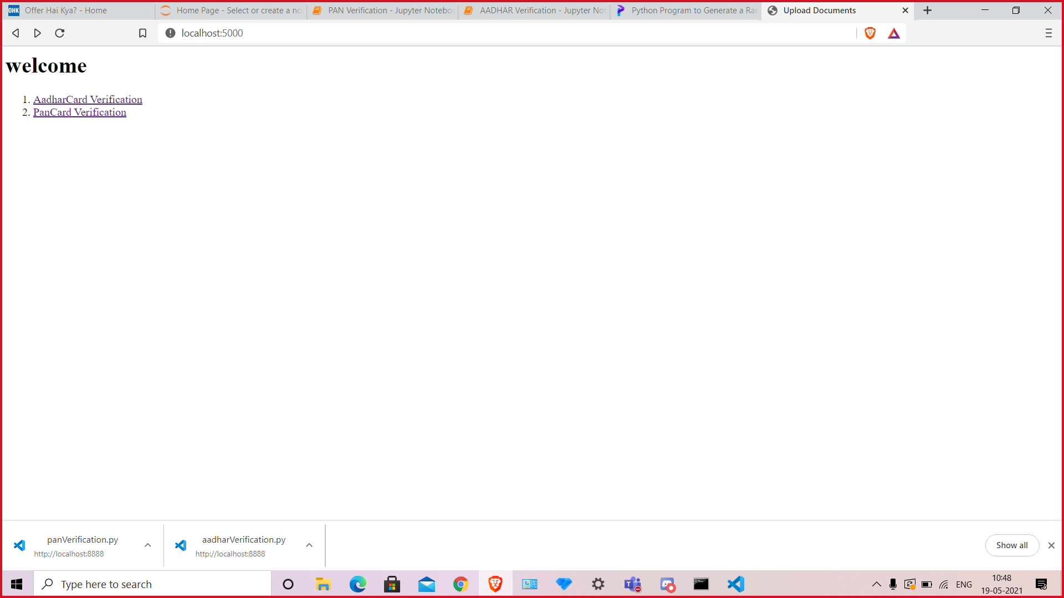
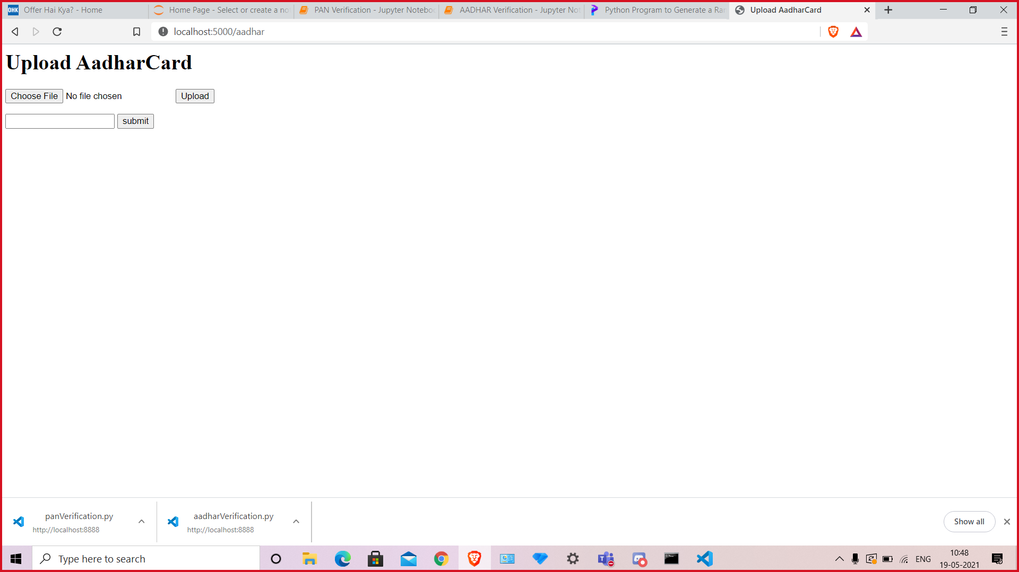
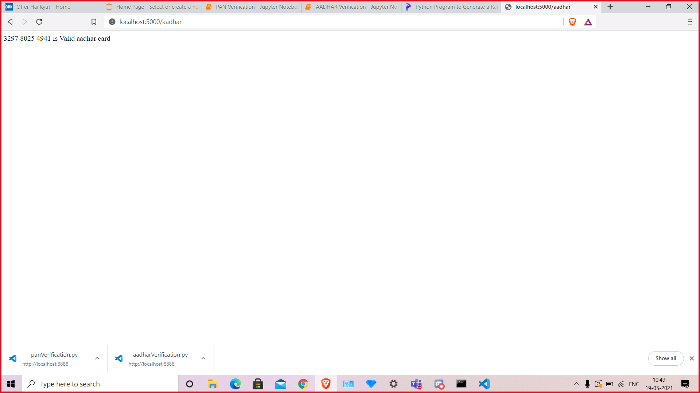
Fig 4: Selection page
Fig 5(a) & (b): Aadhar verification page

Slide 14
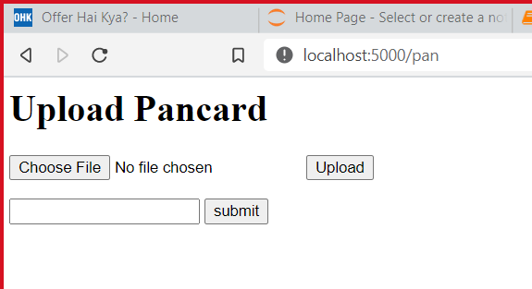

Fig 6(a) & (b): PAN card verification page

Slide 15
REFERENCES
[1] K. Relan, “Building REST APIs with Flask: Create Python Web Services with MySQL” https://doi.org/10.1007/978-1-4842-5022-8_1 2019, ISBN-13 (pbk): 978-1-4842-5021-1 ISBN-13 (electronic): 978-1-4842-5022-8, APRESS
[2] “OpenCV with Python By Example” Book by Prateek Joshi Originally published: 2015
[3] Chirag Indravadanbhai Patel, Dharmendra Patel, “Optical Character Recognition by Open source OCR Tool Tesseract: A Case Study” , International Journal of Computer Applications
(0975 – 8887) Volume 55– No.10, October 2012
[4] Satish Gojar, Rahul Joshi & Dhanashree Gaigaware, “Analysis and Design of Selenium WebDriver Automation Testing Framework”, ) 2nd International Symposium on Big Data
and Cloud Computing (ISBCC’15), ScienceDirect 2015
[5] Alejandra Castelblanco, Jesus Solano, Christian Lopez, Esteban Rivera, Lizzy Tengana, and Mart´ınOchoa, “Machine Learning Techniques for Identity Document Verification in Uncontrolled Environments: A Case Study”, 2020
[6] Miguel Grinberg, “Flask Web Development”, Printed in the United States of America. Published by O’Reilly Media, Inc., 1005, Gravenstein Highway North, Sebastopol, CA95472.

Slide 16
THANK YOU

